Slide 1
BUSINESS PROCESS REENGINEERING
(PHASES 5,6 & 7)
by
Mustafa Shiraz Ahmed
LECTURE 7

Slide 2
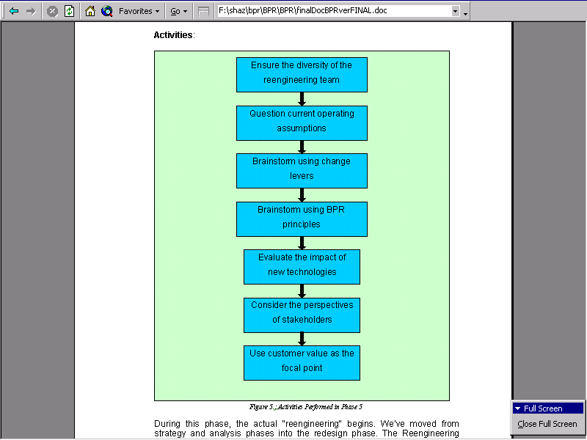
Phase 5 : Reengineer The Process

Slide 3
Phase 5 : Reengineer The Process
During this phase, the actual "reengineering" begins.
We’ve moved from strategy and analysis phases into the redesign phase.
The Reengineering Team that was formed to take part in the reengineering sessions should consist of designers and implementers, including people well versed in technology. These team members should come from both inside and outside the existing process.

Slide 4
Phase 5 : Reengineer The Process
The "inside" perspective may reveal information about the existing process that was not uncovered in Phase 4.
Having people who will be the future process owners, or those responsible for the new process, is a critical component of the Team.
Including the future owners will help to ensure that the reengineered process succeeds once it is implemented.

Slide 5
Phase 5 : Reengineer The Process
Equally important is the "outside" perspective of someone who will look at the process with a "fresh eye" and raise questions about operating assumptions that may not be obvious to the insider who might be too close to the process to see this.

Slide 6
Phase 5 : Reengineer The Process
Lastly, a technologist will provide insight as to how technology can be applied in new and innovative ways.
In other words, the technologist will help to visualize how the process can be performed outside the boundaries of the current implementation.

Slide 7
Phase 5 : Reengineer The Process
Including both outsiders and technologists on the team will help spark "out-of-box" thinking (thinking creatively above and beyond the current restrictions - the walls of the box).

Slide 8
Phase 5 : Reengineer The Process
Having developed a good understanding of how the existing processes work in the previous phase, it is now necessary to question the operating assumptions underlying the processes.

Slide 9
Phase 5 : Reengineer The Process
Is there some (outdated) historical reason why a process has been performed a certain way?
Are there customer requirements that dictate the steps in a process?
Many times the operating assumptions can be thrown out and new ones developed. However, it is important to evaluate the impact the assumptions have outside the process in question.

Slide 10
Phase 5 : Reengineer The Process
The Reengineering Team is now tasked with brainstorming to create new process ideas. According to Hammer, brainstorming sessions are most successful when BPR principles are considered.

Slide 11
Phase 5 : Reengineer The Process
For example, hybrid centralized / decentralized operations encourage the formation of cross-functional workgroups.
Ideally, the Team will identify those processes which should be centralized (because those processes are of value across the enterprise) as well as the processes which are of value to a specific group within the organization.

Slide 12
Phase 5 : Reengineer The Process
A company might maintain a customer database on a centralized system, but it would provide data for a variety of processes throughout the organization such as sales, purchasing, or accounts receivables.

Slide 13
Phase 5 : Reengineer The Process
During the brainstorming sessions, the Reengineering Team must also consider new technologies.
They will need to evaluate the impact of new technology on the process.
Technologies that are often considered enablers of reengineering include: distributed computing platforms, client/sever architectures, workflow software, and application development tools.

Slide 14
Phase 5 : Reengineer The Process
The Reengineering Team should also search for uses of new information as well as new ways to use existing information.
The reengineered process may enable the organization to collect data that was not gathered before, thereby bringing new knowledge into the process to help in decision making.
Another benefit is the sharing of data across the organization to eliminate redundancies in data storage and increase internal communication.

Slide 15
Phase 5 : Reengineer The Process
The act of reengineering a process may require evaluation of the organizational model and the management strategy. A newly formed cross-functional workgroup will not fall neatly into a traditional hierarchical management structure.
In addition, this workgroup will most likely require new measurement systems and reward programs.
Changes in the infrastructure can also have an impact on corporate values and belief systems.
It may be found at this stage that a new process simply will not fit into the current organization without a new process-oriented organizational structure.

Slide 16
Phase 5 : Reengineer The Process
Lastly, the Reengineering Team must consider all process stakeholders in the redesign of a process.
Stakeholders are those whose actions impact the organization, and those who are impacted by the organization’s actions.
Stakeholders include both those internal to the process and those external to the process.
External stakeholders may not be concerned with how a process is performed but they are certainly concerned with the output of the process if they are the recipients.

Slide 17
Phase 5 : Reengineer The Process
Throughout this phase, the Team must consider the impact on external processes that interact with the reengineered process.
Does the implementation of client/server architecture have an effect on another process?
Will that process need to be reengineered also?
Reengineering cannot be performed in a vacuum. However, it cannot be performed on all processes simultaneously either.

Slide 18
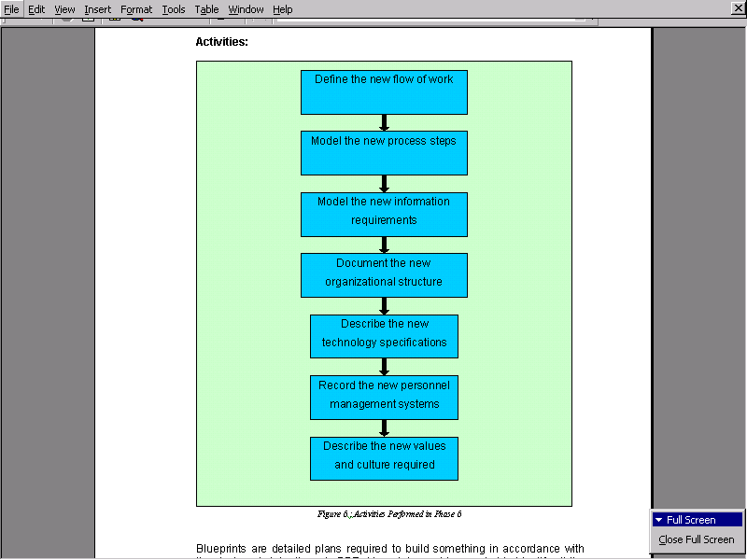
Phase 6 : Blueprint the New Business System

Slide 19
Phase 6 : Blueprint the New Business System
Blueprints are detailed plans required to build something in accordance with the designer’s intentions.
In BPR, blueprints must be created to identify all the necessary details of the newly reengineered business system and ensure it will be built as intended.
This phase of the project takes the reengineered process developed in the previous phase, and provides the details necessary to actually implement it.

Slide 20
Phase 6 : Blueprint the New Business System
Blueprinting involves modeling the new process flow and the information required to support it.
Just as we modeled the "as is" process and information requirements in Phase 4, we need to create "to be" models to illustrate how the workflow will be different.
The information models, or data models, will indicate where the new process will use information that is shared across functional areas of the business.

Slide 21
Phase 6 : Blueprint the New Business System
The blueprints should also contain models of the redesigned organizational structure.
Instead of the traditional organization chart, a different kind of chart is needed. This chart will show the new process flow along with the process team members, the process owners, the case managers, the process facilitators.
The chart should also indicate parts of the organization which interact with the process personnel.

Slide 22
Phase 6 : Blueprint the New Business System
In addition, detailed technology specifications required to support the new process should be defined.
Although minor changes, or fine tuning adjustments to the technical configuration will probably occur during the implementation phase, an initial physical description of the technologies used and their physical specifications should be recommended in this phase, to set the stage for rapid application development.

Slide 23
Phase 6 : Blueprint the New Business System
Included in the blueprints should be the new management systems and values or belief systems of this redesigned area of the business.
New management strategies, along with new performance measurements, compensation systems, and rewards programs should be outlined.
The reengineered process may require a change in the values or belief systems of the company.

Slide 24
Phase 6 : Blueprint the New Business System
The redesign may require an entirely different culture, or atmosphere, than what is prevalent in the organization today. ]
It is critical to have these areas, and their responsibilities, defined as we go into the implementation phase.

Slide 25
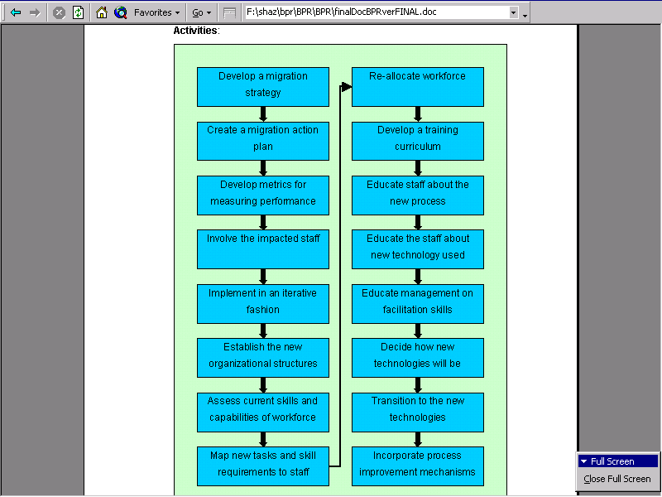
Phase 7: Perform the Transformation

Slide 26
Phase 7: Perform the Transformation
Now we are ready to transform the organization.
We have communicated, strategize, analyzed, reengineered, and blueprinted our ideas for the new process.
This is where all of the previous efforts are combined into an actual business system something we can see and feel and use to enable our organization to meet the market demands of today and tomorrow.

Slide 27
Phase 7: Perform the Transformation
The first step in transforming the organization is to develop a plan for migrating to the new process.
We need a path to get from where the organization is today, to where the organization wants to be.
Migration strategies include: a full cutover to the new process, a phased approach, a pilot project, or creating an entirely new business unit.

Slide 28
Phase 7: Perform the Transformation
An important point to consider is the integration of the new process with other processes.
If only one process is reengineered, then it must interact with the other existing processes.
If multiple processes are slated for reengineering, then the new process must not only integrate with existing processes, but also with the newly reengineered processes that will come on line in the near future; therefore, the implementation of the new process must be flexible enough to be easily modified later on.

Slide 29
Phase 7: Perform the Transformation
Successful transformation depends on consciously managing behavioral as well as structural change, with both sensitivity to employee attitudes and perceptions, and a tough minded concern for results.
BPR Implementation requires the reorganization, retraining, and retooling of business systems to support the reengineered process.

Slide 30
Phase 7: Perform the Transformation
The new process will probably require a new organization, different in structure, skills, and culture.
The new management structure should result in the control paradigm being changed to the facilitation paradigm.
The new process team structure should result in the managed paradigm being changed to the empowered paradigm.

Slide 31
Phase 7: Perform the Transformation
Once the new structures are established, we should map tasks in the process to functional skill levels, and ultimately to workers.
Transforming the workforce will require an array of activities.
It begins with an assessment of the current skills or capabilities of the workforce to include soft skills, operational skills, and technical skills.

Slide 32
Phase 7: Perform the Transformation
This inventory may require personal evaluations (including areas of interest), peer evaluations, and supervisor evaluations.
Feedback should be provided to all personnel to ensure accuracy of current skills and interests for all staff.
Armed with the new process skill requirements and a current skills inventory, the gaps can be assessed.

Slide 33
Phase 7: Perform the Transformation
Is the new process feasible with the current skill set?
Which are the areas to focus on to enhance personnel skills to meet the requirements of the new process?
An education curriculum needs to be established to get all employees educated on the business and, most important, on how their jobs relate to the customer.

Slide 34
Phase 7: Perform the Transformation
An educational pyramid is an effective way to transfer knowledge of team building, self mastery, and subject matter knowledge.
Systems’ training is essential to understanding the use of new information systems and how to take advantage of their capabilities.
Process training may be needed to help employees think beyond a linear process to a more holistic interdependent process.

Slide 35
Phase 7: Perform the Transformation
Facilitation training for management is critical to develop their abilities to listen, allow mistakes, handle disputes among process experts, and transition to a coach/facilitator role.
Education may be necessary for Total Quality Management (TQM), Statistical Process Control (SPC), or Continuous Process Improvement (CPI) if these mechanisms are designed into the new processes.

Slide 36
Phase 7: Perform the Transformation
Finally, a structured on-the-job training (OJT) program is instrumental in providing continuity of the new process during periods of personnel turnover or attrition.

Slide 37
Phase 7: Perform the Transformation
As with any dramatic change, people will have personal difficulties, to varying degrees, with the paradigm shift that has taken place.
Almost all new process implementations are surrounded by confusion, frustration, and sometimes panic.
The best transition strategy is one that minimizes, as much as possible, the interference caused to the overall environment.

Slide 38
Phase 7: Perform the Transformation
Attempts should be made to keep the new process chaos to a controlled level, to maintain the focus of the reengineering team and the faith of the employees.

Slide 39
Phase 7: Perform the Transformation
Transforming information systems to support the new process may involve retooling the hardware, software, and information needs for the new process.
One approach to this transition could be a controlled introduction.
The method would ensure that each part of the system is operational for a segment of the business before going on to the next module to implement.

Slide 40
Phase 7: Perform the Transformation
Although the risk may be low while the bugs in the new system are ironed out, it may be difficult to integrate the hybrid old/new systems in a step-wise manner.
The flash cut approach is where the entire system is developed in parallel to the existing system, and a complete transition occurs all at once.
This may put the organization at a higher risk if the systems do not function properly at first, but it is the more common approach due to the "all-or-nothing" nature of BPR.

Slide 41
Phase 7: Perform the Transformation
Most reengineered processes function in an entirely different manner than existing processes; thus, a step-wise introduction would, most likely, not be fully functional until all steps were introduced anyway.
An important reason to justify the flash cut approach is that the reengineering benefits can be realized much sooner than with a controlled introduction.

Slide 42
Phase 7: Perform the Transformation
Transitioning the information used to support the old process to become useful in the new process involves reducing some requirements while expanding others.
Usually 30 to 40% of the old information can be discarded because it was administrative data needed to tie the old disjointed, linear processes together.

Slide 43
Phase 7: Perform the Transformation
On the other hand, the old systems may have poor data integrity, incorrect data, or insufficient data to support the new business needs.
In these cases the data must be expanded to fill the gaps in the existing data and supply the new information requirements of the reengineered process.
The information blueprints help manage the development of the new information systems

Slide 44
Phase 7: Perform the Transformation
The thoughts of management experts, the experiences of management consulting firms, and the research conducted by academicians have resulted in the methods and procedures outlined in this document.
In order to establish the dramatic change we are seeking, we need to dramatically increase our chances of successful BPR.

Slide 45
Conclusion
The phases and activities described here must be considered, as a minimum, when attempting to successfully plan and perform Business Process Reengineering.

